Slide 1
Emotion Detection for Online Communications
Submitted by: Navya Vemireddy

Slide 2
Objectives
The primary objective of this project is to develop and evaluate a deep learning-based model for accurately detecting and classifying emotions in online communications, leveraging advanced natural language processing (NLP) techniques. In addition to emotion detection, the project aims to achieve the following NLP-related objectives:
Named Entity Recognition (NER): Enhancing contextual understanding by identifying entities like names, locations, and organizations in online communications.
Sentiment Analysis: Providing a broader insight into emotional content by discerning overall sentiment alongside specific emotions.
Contextual Understanding: Improving emotion classification accuracy by interpreting contextual nuances like sarcasm, irony, and cultural references in online communications.
Multimodal Integration: Enabling a comprehensive emotion detection approach by integrating various data sources such as text, images, and emojis.

Slide 3
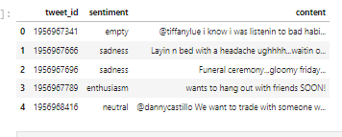
DATASET
The "Emotion Detection from Text" dataset available on Kaggle is likely to be valuable for your project, especially since you're working on sentiment analysis and emotion detection. This dataset can provide labeled text data with associated emotions, allowing us to train and test your sentiment analysis models effectively.
By using this dataset, you can enhance the accuracy and robustness of your models in detecting and classifying emotions in textual data.
Additionally, having a diverse range of emotions in the dataset can help ensure that our models can handle various emotional expressions, making them more suitable for real-world applications where emotions can be nuanced and multifaceted.

Slide 4
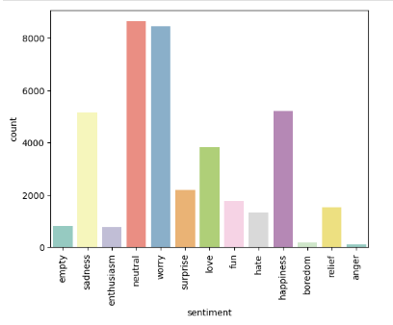
Sentiments frequency

Slide 5
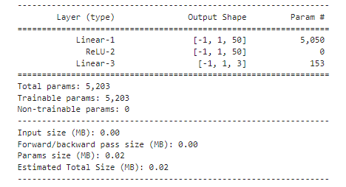
simple neural network model
The model architecture presented comprises two linear layers, Linear-1 and Linear-3, separated by a Rectified Linear Unit (ReLU) activation function, denoted as ReLU-2. Linear-1 serves as the input layer, transforming input data into a 50-dimensional output. ReLU-2 introduces non-linearity to the model, enhancing its capacity to capture complex patterns in the data. Following ReLU-2, Linear-3 acts as the output layer, converting the 50-dimensional input from ReLU-2 into a 3-dimensional output, typically representing the number of classes or categories in the model's prediction task.
With a total of 5,203 trainable parameters, this architecture strikes a balance between complexity and computational efficiency, making it suitable for tasks where computational resources are limited while still allowing the model to learn meaningful representations from the input data.

Slide 6
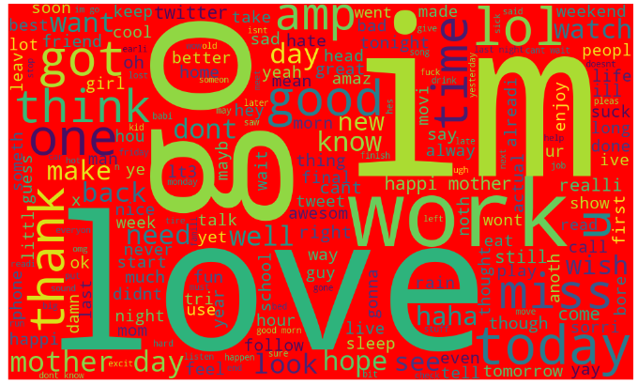
TEXT PROCESSING
Tokenization: Breaking down text into smaller units such as words or subwords (tokens) to facilitate further analysis and processing.
Text Cleaning: Removing noise, such as punctuation, stopwords, and special characters, and performing tasks like lowercasing and stemming to normalize text data.
Text Vectorization: Converting text into numerical vectors, often using techniques like Term Frequency-Inverse Document Frequency (TF-IDF) or word embeddings (e.g., Word2Vec, GloVe) to represent words or documents numerically.
Named Entity Recognition (NER): Identifying and classifying named entities such as persons, organizations, locations, and other entities in text data..
Sentiment Analysis: Determining the sentiment or emotional tone expressed in text, such as positive, negative, or neutral sentiments.

Slide 7
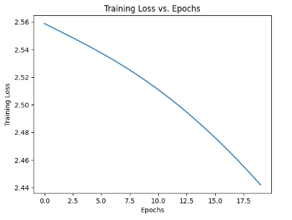
MODEL FINETUNING
The loss trend you've provided reflects the training progress of a machine learning model over 20 epochs. The decreasing trend, starting from a loss of 2.56 in the first epoch and gradually reducing to 2.44 in the final epoch, indicates that the model is learning from the training data and improving its ability to make accurate predictions.
A decreasing loss suggests that the model's predictions are getting closer to the actual target values, which is a positive indication of learning and optimization during the training process.

Slide 8
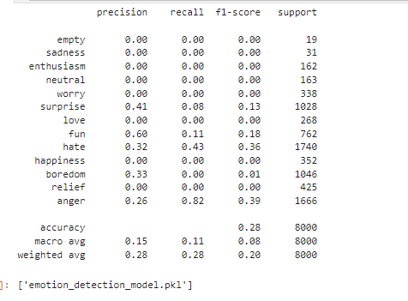
Model PERFORMANCE
. The report reveals a diverse range of precision, recall, and F1-score values across different emotions, indicating the model's varying effectiveness in correctly predicting instances for each class.
Categories like 'anger' exhibit relatively higher recall and F1-scores, suggesting better performance in identifying instances of anger compared to other emotions. Conversely, emotions such as 'empty,' 'sadness,' and 'neutral' show lower precision, recall, and F1-scores, indicating challenges in accurately predicting these classes.
The overall accuracy of 28% reflects the model's moderate performance in classifying emotions, emphasizing the need for further refinement and optimization, especially for classes with lower predictive accuracy.

Slide 9
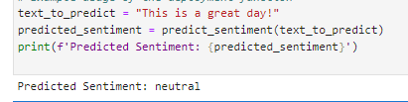
DEPLOYMENT
Deployment process ensures that the sentiment analysis model can effectively process input text, make accurate predictions, and present the predicted sentiment for user interpretation and further action.

Slide 10
References
[1] L. Romero Gomez, T. Watt, and K. O. Babaagba, "Emotion Recognition on Social Media Using Natural Language Processing (NLP) Techniques," Edinburgh Napier University, Edinburgh EH10 5DT, United Kingdom, 2019.
[2] D. SakethNath, H. Kaur, and A. Singh, "Emotion Detection using Natural Language Processing," in 2022 5th International Conference on Contemporary Computing and Informatics (IC3I), Uttar Pradesh, India, 2022, pp. 1237-1242, doi: 10.1109/IC3I56241.2022.10072841.
[3] M. Anjaria and R.M.R. Guddeti, "Influence factor based opinion mining of Twitter data using supervised learning," in 2014 Sixth International Conference on Communication Systems and Networks (COMSNETS), pp. 1–8, 2014.

Slide 11
Thankyou

